Slide 1
Data Privacy and Legal and Ethical Aspects of Data Management
Week 12
Dr. Farshid Keivanian

Slide 2
Week 12: Outline
Key Concepts – Data Transparency, Ethics, and Privacy
Story 1: The Consent Confusion at MedData Research
Story 2: The Algorithm Audit at EduTrack Analytics
Part B – Independent Work on Assessment 3 (60 minutes)
Week 12 – Milestone Unlocked: From Raw Data to Reliable Insights
Have You Completed the Survey

Slide 3
Key Concepts – Data Transparency, Ethics, and Privacy
1. Data Transparency & Accountability
Organisations must be open about how they collect, use, and share data.
Clear records and audit trails build trust and responsibility.
2. Ethical Data Practices
Follow fairness, honesty, and respect when handling people’s data.
Make decisions that are ethical, not just legal.

Slide 4
Key Concepts – Data Transparency, Ethics, and Privacy
3. Privacy Laws & Protection
Australian Privacy Act (APPs): Sets rules for how businesses handle personal info.
EU GDPR: European law that gives individuals strong rights over their data.

Slide 5
Key Concepts – Data Transparency, Ethics, and Privacy
4. Key Terms to Know
Personal information: Data that identifies a person (name, email, address).
Sensitive information: Private details like health, beliefs, or ethnicity.
Privacy policy: Explains how an organisation manages and protects data.
Data ethics: Doing the right thing with data — not just what’s allowed.

Slide 6
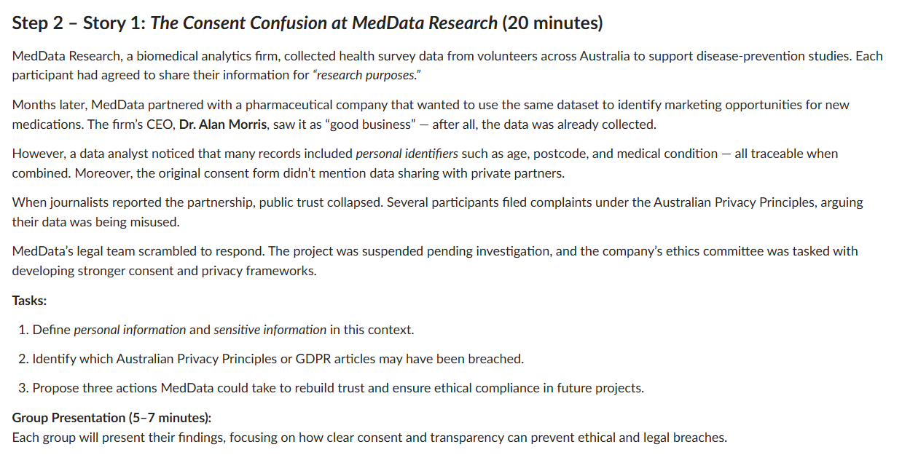

Story 1: The Consent Confusion at MedData Research
Explain key terms — define personal information and sensitive information in this case.
Find privacy breaches — identify which APPs or GDPR rules may have been broken.
Suggest solutions — propose three actions MedData can take to rebuild trust and ensure ethical data use.
Then, present their findings in a 5–7 minute group discussion, showing how clear consent and transparency prevent data misuse.

Slide 7
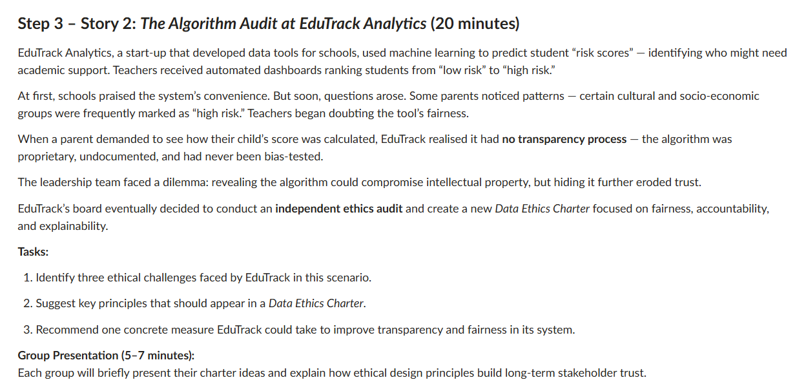
Story 2: The Algorithm Audit at EduTrack Analytics
Find issues – Identify three ethical challenges EduTrack faced (e.g., bias, lack of transparency, or fairness).
Suggest principles – List key ideas for a Data Ethics Charter (like fairness, accountability, and explainability).
Recommend one action – Propose a practical step EduTrack can take to make its system more transparent and fair.
Then, in a 5–7 minute group talk, explain how these ideas help build long-term trust with schools, parents, and students.

Slide 8
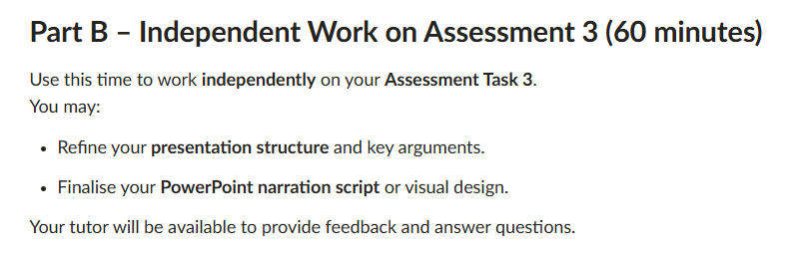
Part B – Independent Work on Assessment 3 (60 minutes)

Slide 9
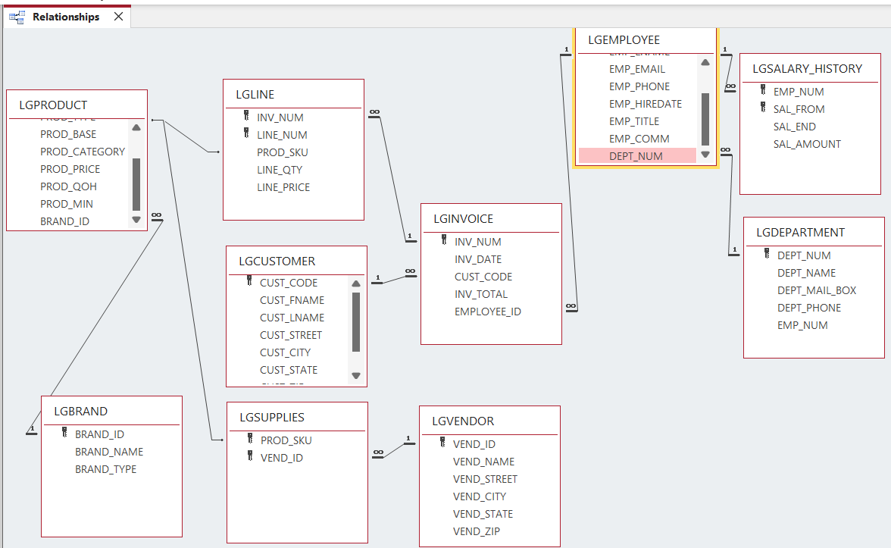
Part B – Independent Work on Assessment 3 (60 minutes)
Save and Verify
Click Save Layout (Ctrl+S).
You should now see all relationship lines with 1–∞ symbols.
Close the window.

Slide 10
Part B – Independent Work on Assessment 3 (60 minutes)
Visual Check Summary
Relationship | From Table | Field | To Table | Field | Type
1 | LGINVOICE | Cust_Code | LGCUSTOMER | Cust_Code | 1–∞
2 | LGINVOICE | Employee_ID | LGEMPLOYEE | Emp_Num | 1–∞
3 | LGLINE | Inv_Num | LGINVOICE | Inv_Num | 1–∞
4 | LGLINE | Prod_SKU | LGPRODUCT | Prod_SKU | 1–∞
5 | LGPRODUCT | Brand_ID | LGBRAND | Brand_ID | 1–∞
6 | LGSUPPLIES | Vend_ID | LGVENDOR | Vend_ID | 1–∞
7 | LGSUPPLIES | Prod_SKU | LGPRODUCT | Prod_SKU | 1–∞
8 | LGEMPLOYEE | Dept_Num | LGDEPARTMENT | Dept_Num | 1–∞
9 | LGSALARY_HISTORY | Emp_Num | LGEMPLOYEE | Emp_Num | 1–∞

Slide 11
Part B – Independent Work on Assessment 3 (60 minutes)
2. Create Each Query
Use Query Design (QBE) or SQL View.
Name them exactly: Query 1, Query 2, … Query 15.
Each query must correspond to the question number below.

Slide 12
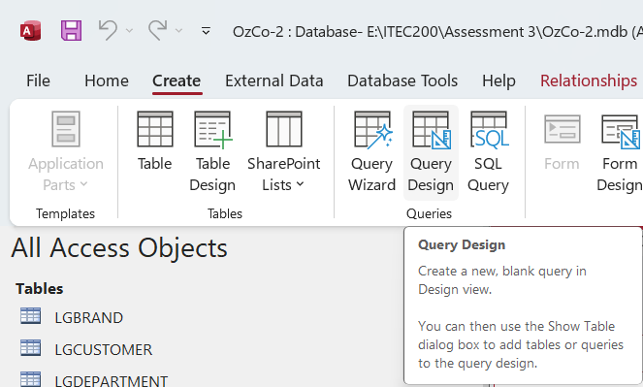
Part B – Independent Work on Assessment 3 (60 minutes)
How to Create Each Query
On the Create tab → click Query Design.
Add the required table(s).
Switch to SQL View (bottom-right corner).
Paste the SQL statement below.
Save as Query 1, Query 2, etc.

Slide 13
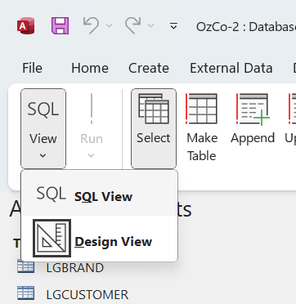
Part B – Independent Work on Assessment 3 (60 minutes)
Query 1 – Customers in NY or OH with balance > $1000

Slide 14
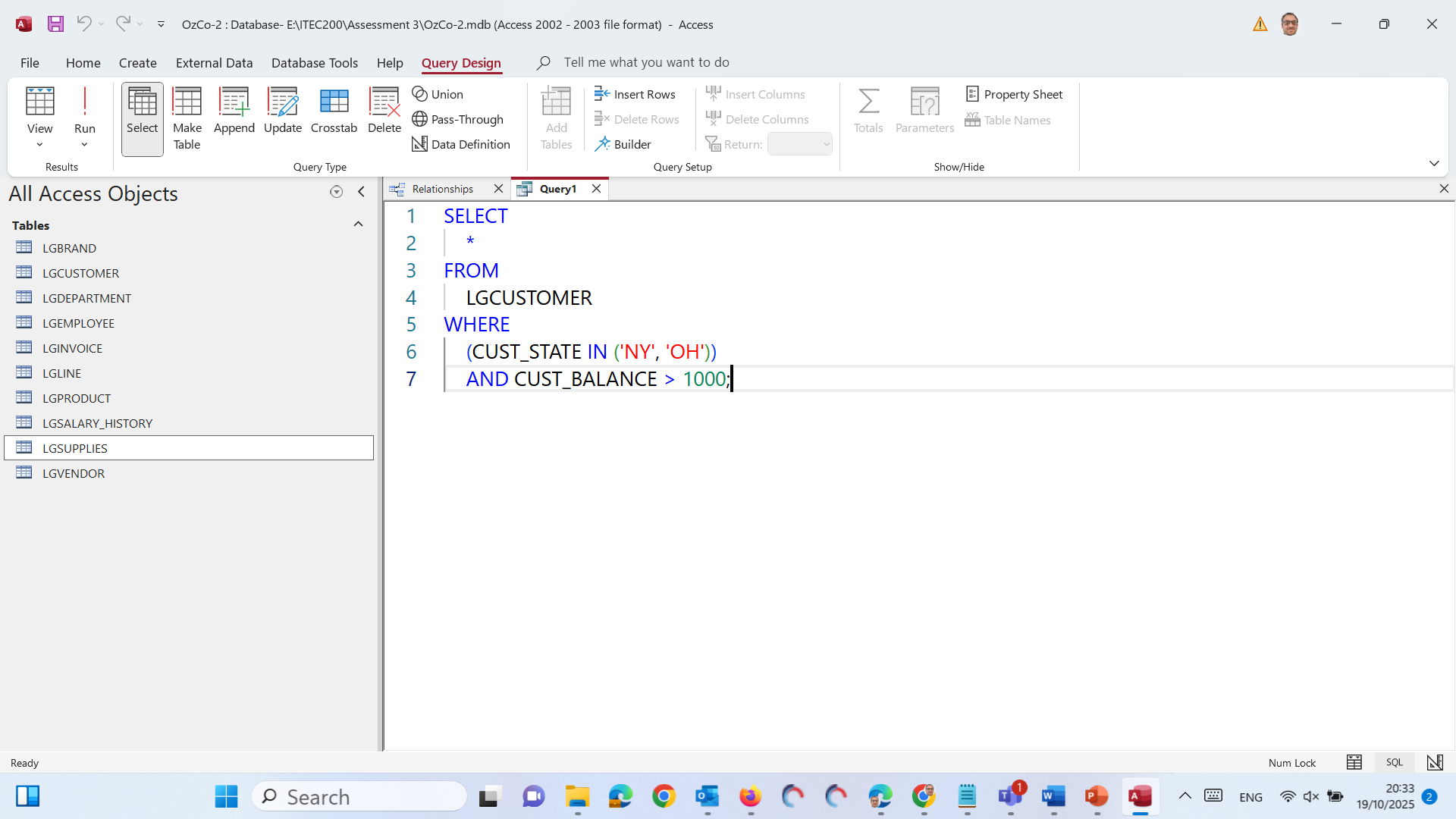
Part B – Independent Work on Assessment 3 (60 minutes)
Run
SELECT * → Show all columns of data.
FROM LGCUSTOMER → Get the data from the table called LGCUSTOMER.

Slide 15
Part B – Independent Work on Assessment 3 (60 minutes)
Run
WHERE (CUST_STATE IN ('NY', 'OH')) → Only include customers who live in New York (NY) or Ohio (OH).

Slide 16
Part B – Independent Work on Assessment 3 (60 minutes)
Run
AND CUST_BALANCE > 1000 → Also, only include customers whose balance is greater than 1000.

Slide 17
Part B – Independent Work on Assessment 3 (60 minutes)
Run
In short, Show all customer records from the LGCUSTOMER table where the customer lives in New York or Ohio and owes more than $1000.

Slide 18
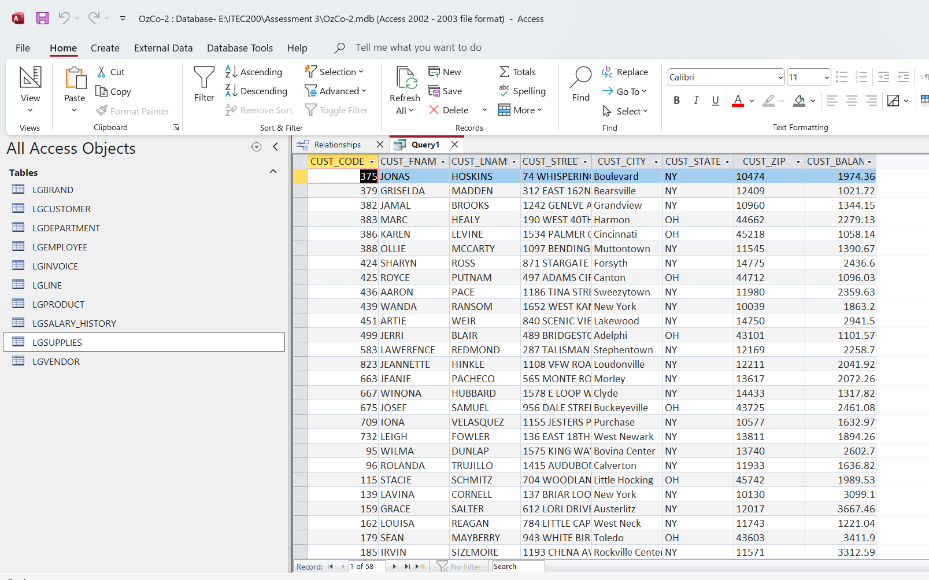
Part B – Independent Work on Assessment 3 (60 minutes)

Slide 19
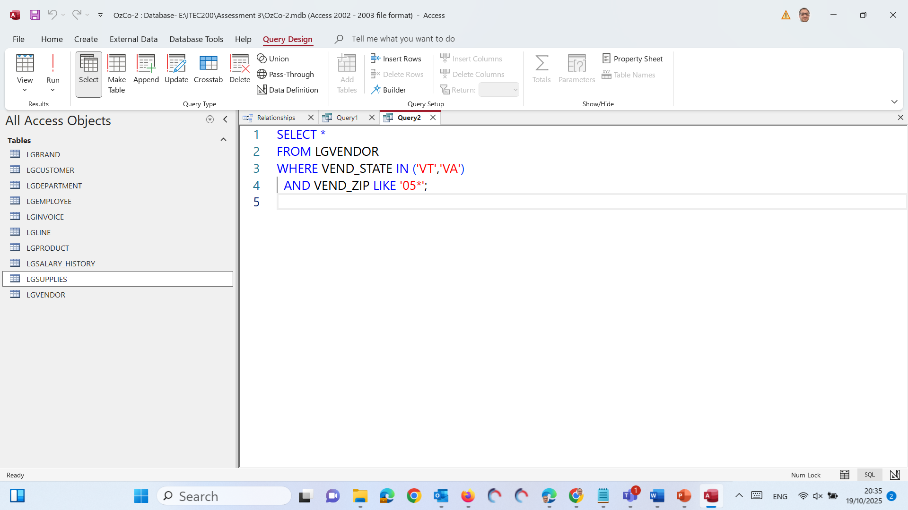
Part B – Independent Work on Assessment 3 (60 minutes)
Query 2 – Vendors in VT or VA whose ZIP starts with 05
SELECT * → Show all columns (all information) about each vendor.

Slide 20
Part B – Independent Work on Assessment 3 (60 minutes)
Query 2 – Vendors in VT or VA whose ZIP starts with 05
FROM LGVENDOR → The data is taken from the LGVENDOR table.

Slide 21
Part B – Independent Work on Assessment 3 (60 minutes)
Query 2 – Vendors in VT or VA whose ZIP starts with 05
WHERE VEND_STATE IN ('VT', 'VA') → Only include vendors located in Vermont (VT) or Virginia (VA).

Slide 22
Part B – Independent Work on Assessment 3 (60 minutes)
Query 2 – Vendors in VT or VA whose ZIP starts with 05
AND VEND_ZIP LIKE '05*' → Also, only include vendors whose ZIP code starts with “05”.

Slide 23
Part B – Independent Work on Assessment 3 (60 minutes)
Query 2 – Vendors in VT or VA whose ZIP starts with 05
The * means “any characters after 05” — for example: 05123, 05876, etc.

Slide 24
Part B – Independent Work on Assessment 3 (60 minutes)
Query 2 – Vendors in VT or VA whose ZIP starts with 05
In short, show all vendors from Vermont or Virginia whose ZIP code begins with 05

Slide 25
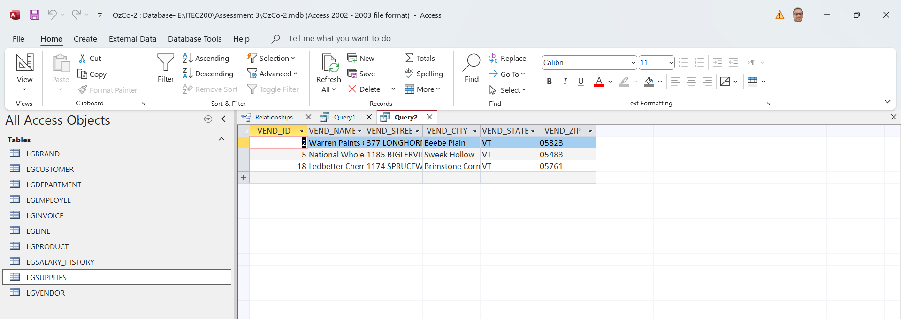
Part B – Independent Work on Assessment 3 (60 minutes)
Query 2 – Vendors in VT or VA whose ZIP starts with 05

Slide 26
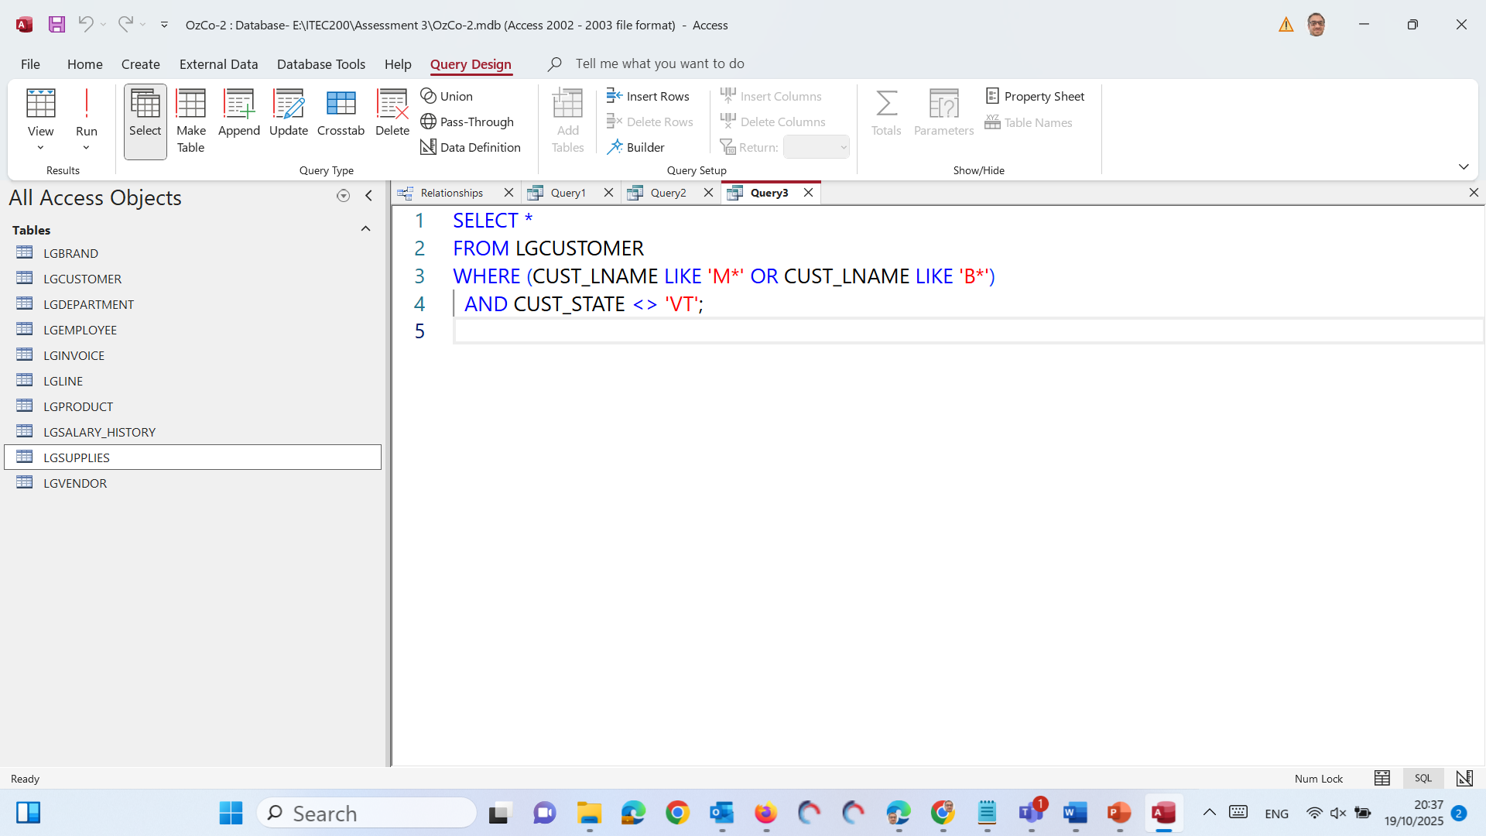
Part B – Independent Work on Assessment 3 (60 minutes)
Query 3 – Customers with last name starting M or B, not in VT
SELECT * → Show all columns of customer information.
FROM LGCUSTOMER → Data comes from the LGCUSTOMER table.

Slide 27
Part B – Independent Work on Assessment 3 (60 minutes)
Query 3 – Customers with last name starting M or B, not in VT
WHERE (CUST_LNAME LIKE 'M*' OR CUST_LNAME LIKE 'B*') → Only include customers whose last name starts with “M” or “B”.

Slide 28
Part B – Independent Work on Assessment 3 (60 minutes)
Query 3 – Customers with last name starting M or B, not in VT
Example: Miller, Brown, Baker, Martin, etc.
AND CUST_STATE <> 'VT' → Exclude customers who live in Vermont (VT).
The symbol <> means “not equal to.”

Slide 29
Part B – Independent Work on Assessment 3 (60 minutes)
Query 3 – Customers with last name starting M or B, not in VT
In short, show all customers whose last name begins with M or B, but who do not live in Vermont (VT).

Slide 30
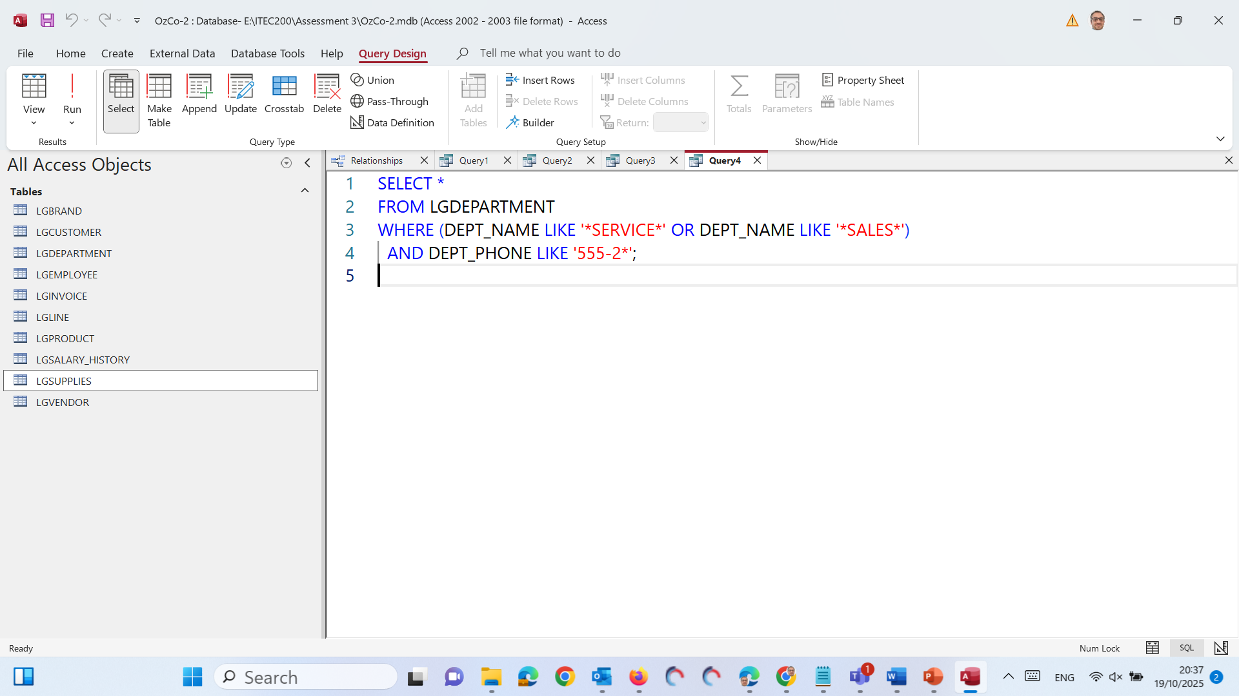
Part B – Independent Work on Assessment 3 (60 minutes)
Query 4 – Departments containing “SERVICE” or “SALES”, phone starts 555-2
SELECT * → Show all columns (every piece of information) from the results.
FROM LGDEPARTMENT → Get the data from the LGDEPARTMENT table.

Slide 31
Part B – Independent Work on Assessment 3 (60 minutes)
Query 4 – Departments containing “SERVICE” or “SALES”, phone starts 555-2
SELECT * → Show all columns (every piece of information) from the results.

Slide 32
Part B – Independent Work on Assessment 3 (60 minutes)
Query 4 – Departments containing “SERVICE” or “SALES”, phone starts 555-2
FROM LGDEPARTMENT → Get the data from the LGDEPARTMENT table.

Slide 33
Part B – Independent Work on Assessment 3 (60 minutes)
Query 4 – Departments containing “SERVICE” or “SALES”, phone starts 555-2
WHERE (DEPT_NAME LIKE '*SERVICE*' OR DEPT_NAME LIKE '*SALES*') → Find departments whose name contains “SERVICE” or “SALES” anywhere in it.
Example: Customer Service, After-Sales Support, etc.

Slide 34
Part B – Independent Work on Assessment 3 (60 minutes)
Query 4 – Departments containing “SERVICE” or “SALES”, phone starts 555-2
AND DEPT_PHONE LIKE '555-2*' → Only include departments whose phone number starts with “555-2” (e.g., 555-2000, 555-2345, etc.).

Slide 35
Part B – Independent Work on Assessment 3 (60 minutes)
Query 4 – Departments containing “SERVICE” or “SALES”, phone starts 555-2
In short, show all departments that have ‘Service’ or ‘Sales’ in their name and whose phone number begins with 555-2.

Slide 36
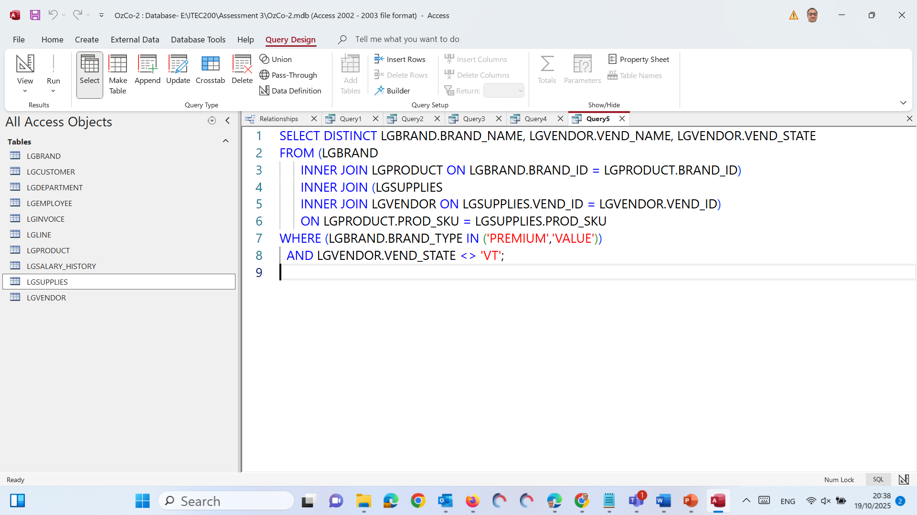
Part B – Independent Work on Assessment 3 (60 minutes)
Query 5 – PREMIUM or VALUE brands whose vendors are not in VT
SELECT DISTINCT → Show each combination of results only once (no duplicates).

Slide 37
Part B – Independent Work on Assessment 3 (60 minutes)
Query 5 – PREMIUM or VALUE brands whose vendors are not in VT
LGBRAND.BRAND_NAME, LGVENDOR.VEND_NAME, LGVENDOR.VEND_STATE → Display the brand name, vendor name, and vendor state.

Slide 38
Part B – Independent Work on Assessment 3 (60 minutes)
FROM ... INNER JOIN ... → Connect several tables together so you can combine brand, product, supply, and vendor data:
LGBRAND is joined with LGPRODUCT using BRAND_ID.
LGPRODUCT connects with LGSUPPLIES using PROD_SKU.
LGSUPPLIES connects with LGVENDOR using VEND_ID. These joins make sure the query links each brand to its vendor through the products and supplies.

Slide 39
Part B – Independent Work on Assessment 3 (60 minutes)
WHERE (LGBRAND.BRAND_TYPE IN ('PREMIUM','VALUE')) → Only include brands that are Premium or Value type.
AND LGVENDOR.VEND_STATE <> 'VT' → Exclude vendors located in Vermont (VT). (<> means “not equal to”).

Slide 40
Part B – Independent Work on Assessment 3 (60 minutes)
In short, show a unique list of all Premium or Value brands and their vendors, but only for vendors not located in Vermont (VT).

Slide 41
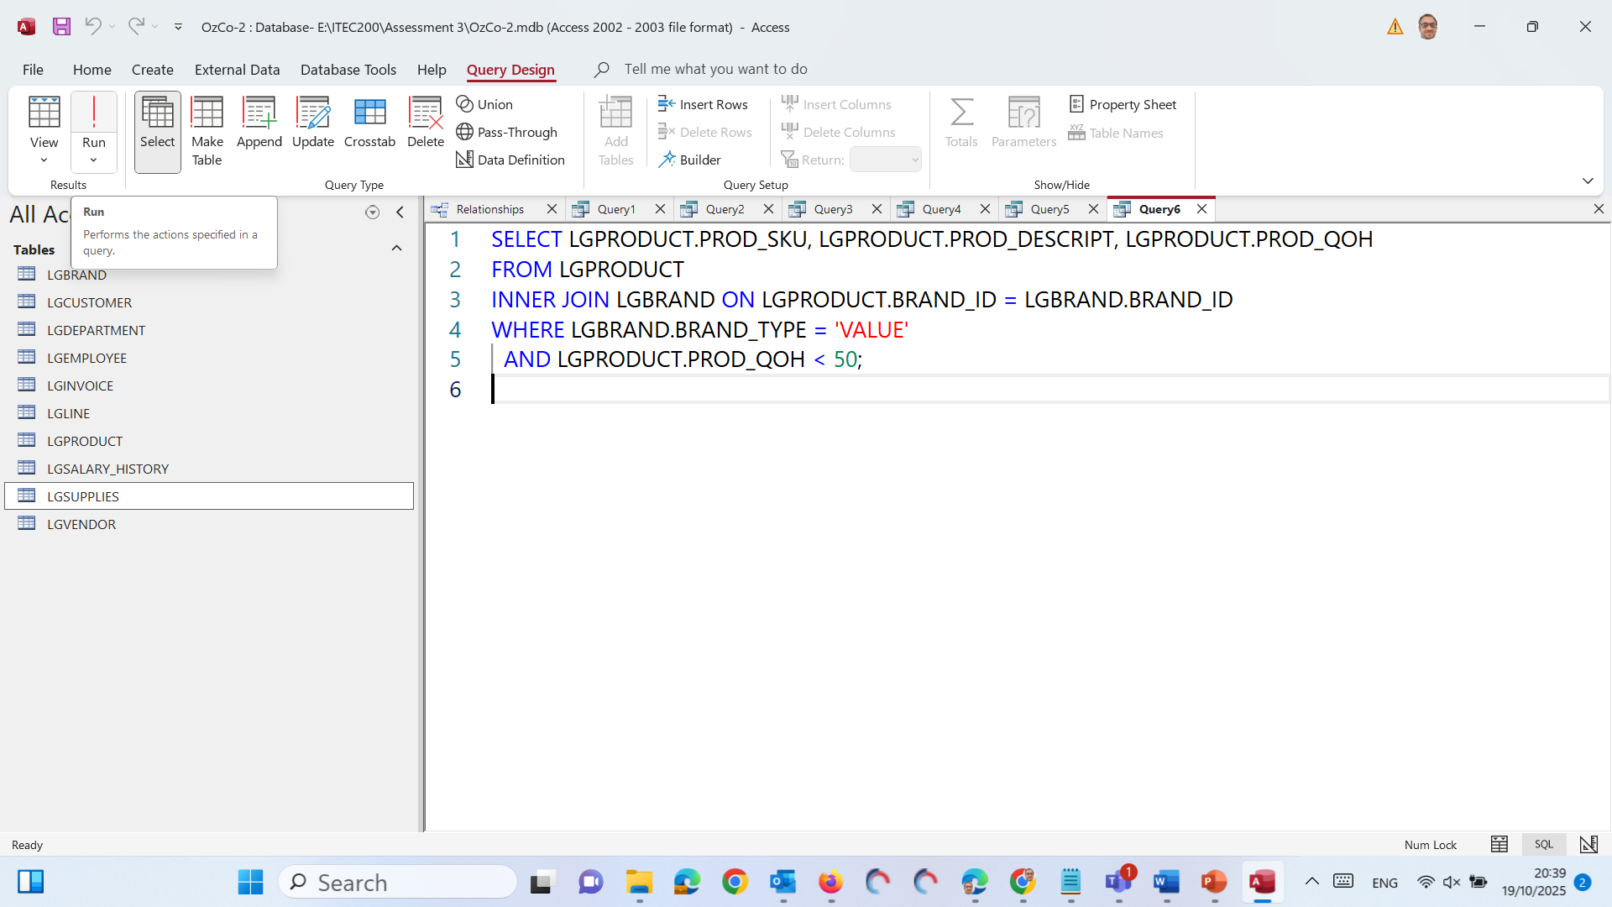
Part B – Independent Work on Assessment 3 (60 minutes)
Query 6 – Products in VALUE brands with quantity on hand < 50
SELECT → Choose the columns to display:
PROD_SKU → Product code
PROD_DESCRIPT → Product description
PROD_QOH → Quantity on hand

Slide 42
Part B – Independent Work on Assessment 3 (60 minutes)
Query 6 – Products in VALUE brands with quantity on hand < 50
FROM LGPRODUCT → Get data from the LGPRODUCT table (the product list).
INNER JOIN LGBRAND ON LGPRODUCT.BRAND_ID = LGBRAND.BRAND_ID → Match each product with its brand based on their shared BRAND_ID field.

Slide 43
Part B – Independent Work on Assessment 3 (60 minutes)
Query 6 – Products in VALUE brands with quantity on hand < 50
WHERE LGBRAND.BRAND_TYPE = 'VALUE' → Only show products that belong to Value brands.
AND LGPRODUCT.PROD_QOH < 50 → Further filter to show only products that have less than 50 units available in stock.

Slide 44
Part B – Independent Work on Assessment 3 (60 minutes)
Query 6 – Products in VALUE brands with quantity on hand < 50
In short, list all products from Value brands that have fewer than 50 items left in stock.

Slide 45
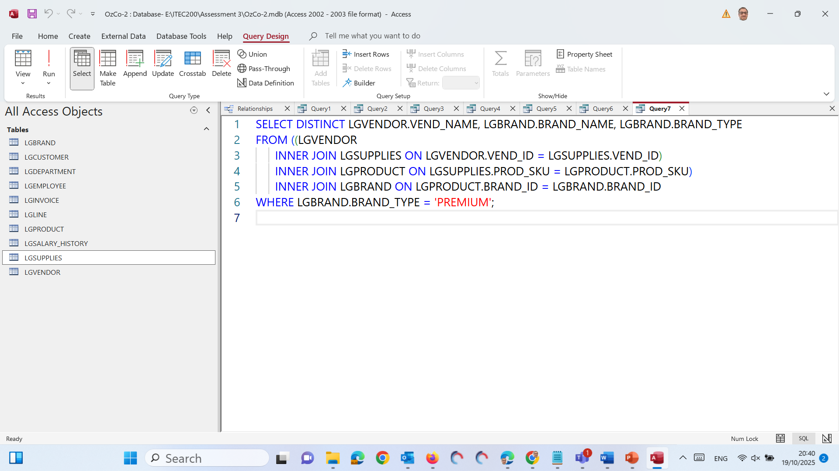
Part B – Independent Work on Assessment 3 (60 minutes)
Query 7 – Vendors supplying PREMIUM-brand products
SELECT DISTINCT → Show each vendor–brand combination only once (no duplicates).

Slide 46
Part B – Independent Work on Assessment 3 (60 minutes)
Query 7 – Vendors supplying PREMIUM-brand products
LGVENDOR.VEND_NAME, LGBRAND.BRAND_NAME, LGBRAND.BRAND_TYPE → Display the vendor name, brand name, and brand type.

Slide 47
Part B – Independent Work on Assessment 3 (60 minutes)
Query 7 – Vendors supplying PREMIUM-brand products
FROM ... INNER JOIN ... → Connect the tables together:
LGVENDOR links with LGSUPPLIES using VEND_ID
LGSUPPLIES links with LGPRODUCT using PROD_SKU
LGPRODUCT links with LGBRAND using BRAND_ID This chain allows Access to trace which vendor supplies which brand’s products.

Slide 48
Part B – Independent Work on Assessment 3 (60 minutes)
Query 7 – Vendors supplying PREMIUM-brand products
WHERE LGBRAND.BRAND_TYPE = 'PREMIUM' → Only include rows where the brand is Premium.

Slide 49
Part B – Independent Work on Assessment 3 (60 minutes)
Query 7 – Vendors supplying PREMIUM-brand products
In short, show a unique list of vendors who supply Premium-brand products, including the brand name and its type.”

Slide 50
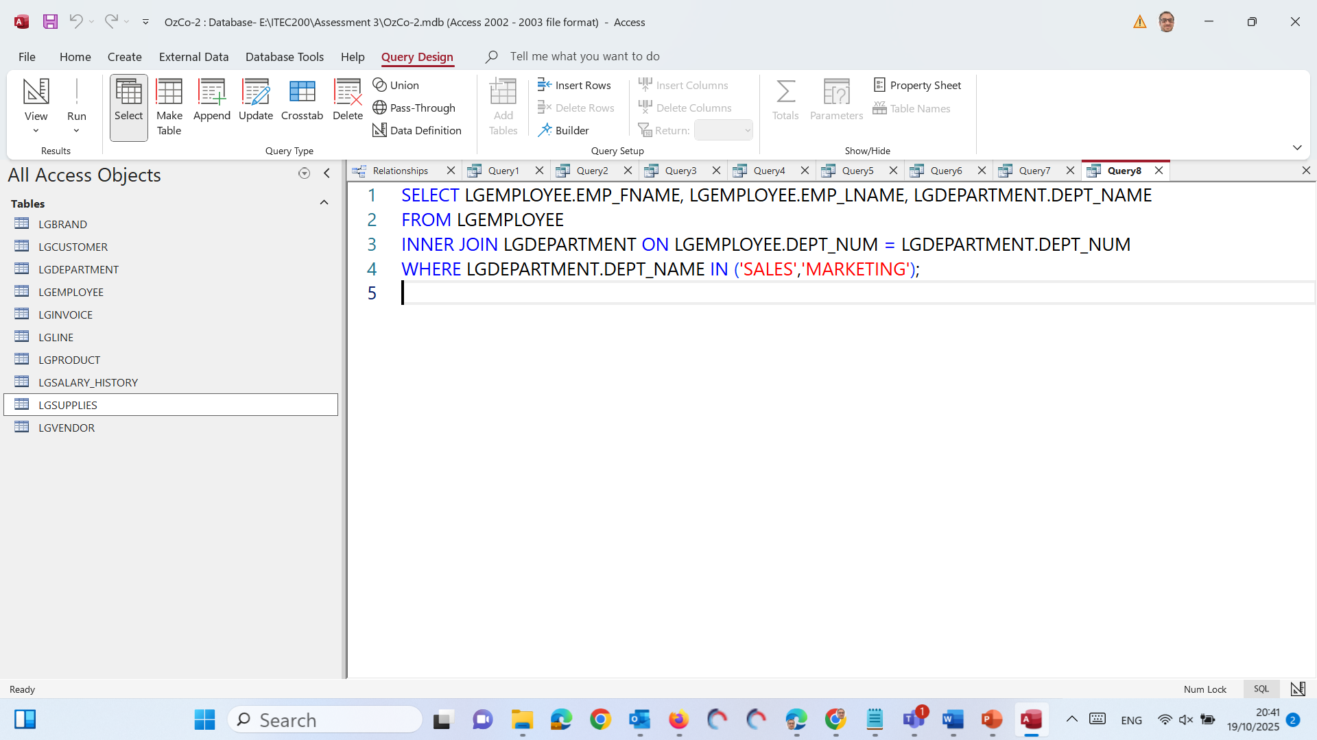
Part B – Independent Work on Assessment 3 (60 minutes)
Query 8 – Employees in SALES or MARKETING departments
SELECT → Choose the fields to display:
EMP_FNAME → Employee’s first name
EMP_LNAME → Employee’s last name
DEPT_NAME → Department name

Slide 51
Part B – Independent Work on Assessment 3 (60 minutes)
Query 8 – Employees in SALES or MARKETING departments
FROM LGEMPLOYEE → Data comes from the LGEMPLOYEE table.

Slide 52
Part B – Independent Work on Assessment 3 (60 minutes)
Query 8 – Employees in SALES or MARKETING departments
INNER JOIN LGDEPARTMENT ON LGEMPLOYEE.DEPT_NUM = LGDEPARTMENT.DEPT_NUM → Connect employees with their corresponding department using the DEPT_NUM (department number).

Slide 53
Part B – Independent Work on Assessment 3 (60 minutes)
Query 8 – Employees in SALES or MARKETING departments
WHERE LGDEPARTMENT.DEPT_NAME IN ('SALES','MARKETING') → Only include employees who work in Sales or Marketing departments.

Slide 54
Part B – Independent Work on Assessment 3 (60 minutes)
Query 8 – Employees in SALES or MARKETING departments
In short, show all employees who work in the Sales or Marketing departments, along with their department name.”

Slide 55
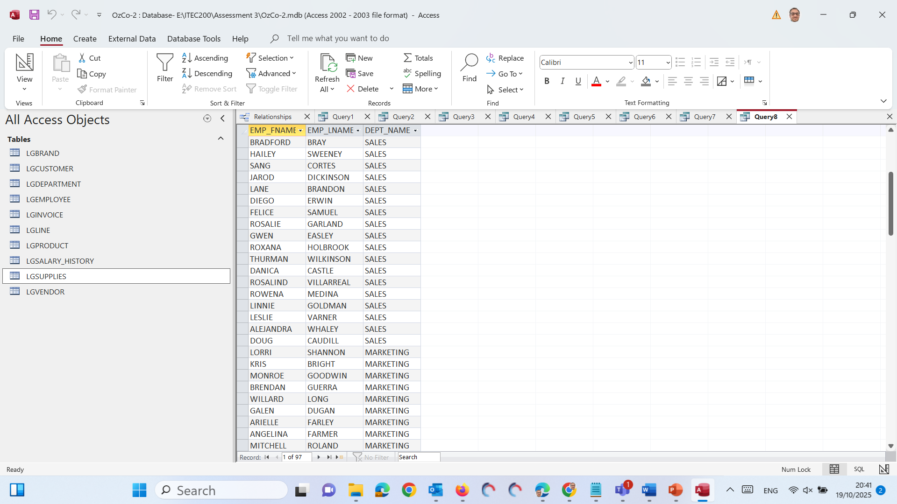
Part B – Independent Work on Assessment 3 (60 minutes)
Query 8 – Employees in SALES or MARKETING departments

Slide 56
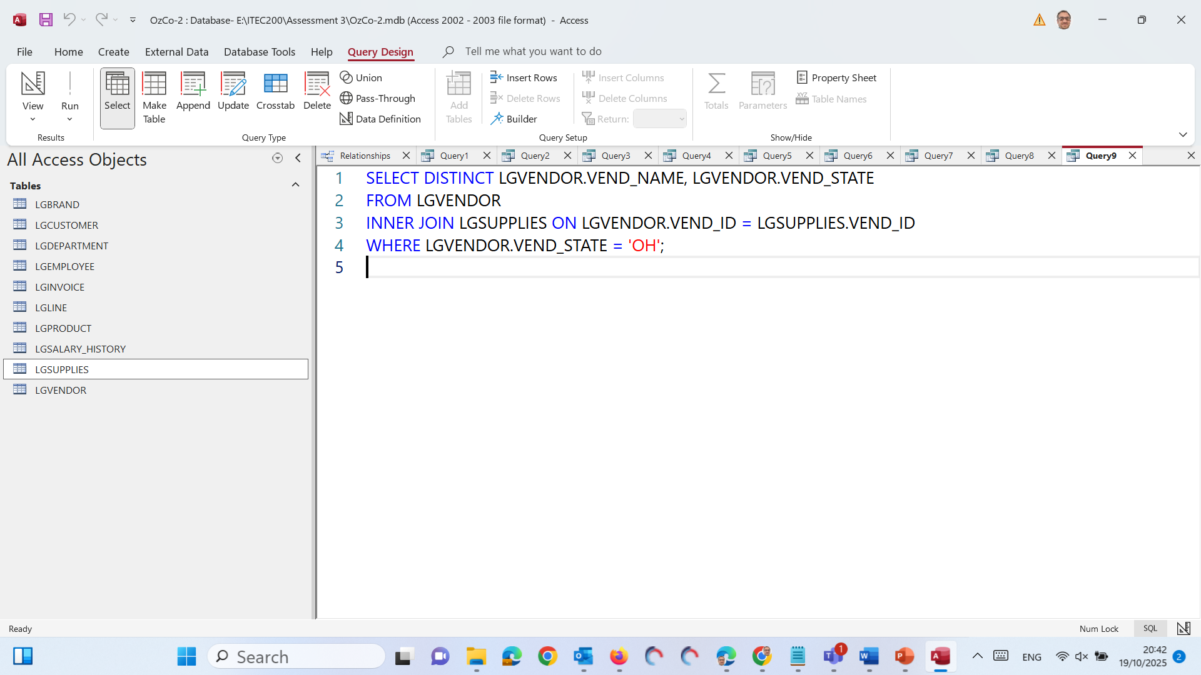
Part B – Independent Work on Assessment 3 (60 minutes)
Query 9 – Vendors in OH that supply any product
SELECT DISTINCT → Show each vendor only once (no duplicate rows).

Slide 57
Part B – Independent Work on Assessment 3 (60 minutes)
Query 9 – Vendors in OH that supply any product
LGVENDOR.VEND_NAME, LGVENDOR.VEND_STATE → Display the vendor’s name and the state they are located in.

Slide 58
Part B – Independent Work on Assessment 3 (60 minutes)
Query 9 – Vendors in OH that supply any product
FROM LGVENDOR → Get vendor data from the LGVENDOR table.

Slide 59
Part B – Independent Work on Assessment 3 (60 minutes)
Query 9 – Vendors in OH that supply any product
INNER JOIN LGSUPPLIES ON LGVENDOR.VEND_ID = LGSUPPLIES.VEND_ID → Link each vendor with the LGSUPPLIES table to show only those vendors who actually supply at least one product.

Slide 60
Part B – Independent Work on Assessment 3 (60 minutes)
Query 9 – Vendors in OH that supply any product
WHERE LGVENDOR.VEND_STATE = 'OH' → Only include vendors located in the state of Ohio (OH).

Slide 61
Part B – Independent Work on Assessment 3 (60 minutes)
Query 9 – Vendors in OH that supply any product
In short, show all vendors in Ohio (OH) who supply any product, listing each vendor only once.

Slide 62
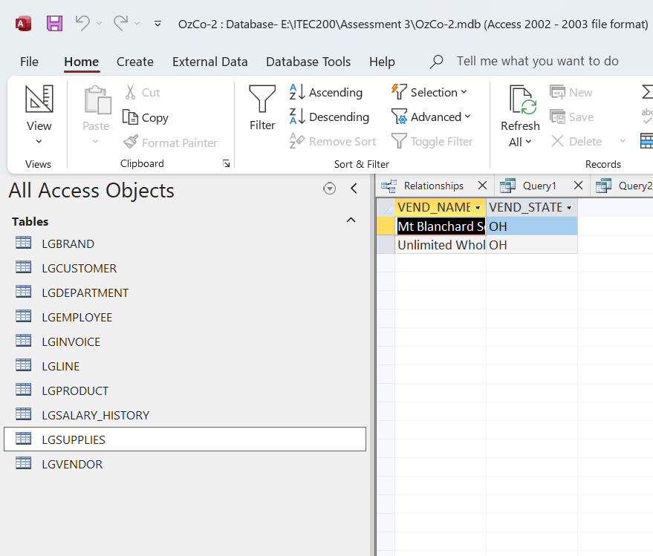
Part B – Independent Work on Assessment 3 (60 minutes)
Query 9 – Vendors in OH that supply any product

Slide 63
Part B – Independent Work on Assessment 3 (60 minutes)
When You’re Done
Save each as Query 1, Query 2, … Query 9...
Run each query once to ensure results display correctly.
Keep the database saved as OzCo-2.accdb (or .mdb) and upload it for Part A submission.
Continue working on the rest of Part A — to Query 15 (there are 15 total queries in the assessment).

Slide 64
Part B – Independent Work on Assessment 3 (60 minutes)
What to Avoid
Common Issue | Correct Practice
Wrong query names | Always “Query 1” … “Query 15”
Missing relationships | Re-link foreign keys before running queries
Using wrong comparison syntax | Text values → in quotes ('VA'); wildcards → LIKE
Only screenshots submitted | Upload the actual Access file (.mdb or .accdb)
<10 working queries | Implement all 15 for full credit

Slide 65
Part B – Independent Work on Assessment 3 (60 minutes)
Submission Requirements
Item | What to Submit | Format
Part A | Completed OzCo database with Queries 1–15 | .accdb or .mdb
File Name | ITEC200_AT3A_StudentID_FullName.accdb | —

Slide 66
Part B – Independent Work on Assessment 3 (60 minutes)
Part B – Recorded Presentation (20 marks)
Scenario: EcoMart — “The Data Dilemma”
A fast-growing eco-retailer faces serious data quality, security, and privacy issues. You are the Data Governance Consultant tasked with analysing the situation and recommending solutions.

Slide 67
Part B – Independent Work on Assessment 3 (60 minutes)
Presentation Goals
Identify and evaluate data-related issues.
Classify issues into: Data Quality, Database Administration & Security, Privacy & Ethics.
Recommend ethical and legally compliant solutions.
Deliver a 7-minute narrated PowerPoint presentation.

Slide 68
Part B – Independent Work on Assessment 3 (60 minutes)
Content Structure
Section | Slides | Guidance
1. Introduction | 1–2 | Introduce EcoMart + why data governance matters + presentation overview
2. Data Quality & Decision-Making | 1–2 | Define data quality; identify 3 issues (e.g., duplicate IDs, missing timestamps, unsynchronised data); explain business impact & solutions (ETL, validation rules, automated refresh)
3. Database Administration & Security | 2–3 | Differentiate DBA vs DA; identify 2 admin issues and 2 security flaws (unrestricted IP access, shared logins); recommend role-based access, VPN firewall rules, MFA, audit logging

Slide 69
Part B – Independent Work on Assessment 3 (60 minutes)
Content Structure
Section | Slides | Guidance
4. Data Privacy & Ethics | 2–3 | Identify ethical/legal risks (no deletion policy, third-party non-GDPR vendor); link to APPs & GDPR compliance
5. Conclusion & Recommendations | 1 | Summarise key actions
6. References | 1 | APA 7th style, ≥ 5 academic sources

Slide 70
Part B – Independent Work on Assessment 3 (60 minutes)
Recording and Submission
Record in PowerPoint: Slide Show → Record Slide Show → Record from Beginning.
Speak clearly; total length ≈ 6–8 minutes (ideal 7 min).
Export to Video: File → Export → Create a Video (Standard 480p).
Ensure timings/narrations enabled.
Keep file < 50 MB (verify via Properties).
Submit MP4 file on Canvas.

Slide 71
Part B – Independent Work on Assessment 3 (60 minutes)
Item | File Name | Format
Part B | ITEC200_AT3B_StudentID_FullName.mp4 | MP4 (video)

Slide 72
Part B – Independent Work on Assessment 3 (60 minutes)
Marking Focus
Category | Key Criteria
Content (10 marks) | Identifies and analyses all major issues; accurate and logical recommendations
Professionalism (5 marks) | Clear speech, logical structure, visual design
Referencing (5 marks) | ≥ 5 academic APA sources, in-text citations + reference slide

Slide 73
Part B – Independent Work on Assessment 3 (60 minutes)
Final Checklist Before Submission
15 queries named and tested successfully.
Database file (.accdb /.mdb) runs without errors.
Presentation 6–8 minutes long and under 50 MB.
References use APA 7th edition.
No AI-generated content (except grammar checking).
Both files uploaded before 5 pm 10 Nov 2025.

Slide 74
Week 12 – Milestone Unlocked: From Raw Data to Reliable Insights
Our students have just completed an inspiring journey through Data Quality, Database Design, and Security — transforming raw data into meaningful business insights!
From building ERD models and enforcing referential integrity in Microsoft Access, to provisioning and deploying relational databases in Azure, running SQL queries, and strengthening data governance, they’ve mastered real-world skills in:

Slide 75
Week 12 – Milestone Unlocked: From Raw Data to Reliable Insights
#DataModeling #SQLQueries #DatabaseSecurity #PowerBI #ETL #ProblemSolving #Azure

Slide 76
Week 12 – Milestone Unlocked: From Raw Data to Reliable Insights
These hands-on projects — from the OzCo relational database to data validation and backup planning — have shaped our learners into confident, job-ready data professionals.
Let’s celebrate this milestone with a #SelfieCelebration!

Slide 77
Week 12 – Milestone Unlocked: From Raw Data to Reliable Insights
#StudentSuccess #ProudMoment #DataAnalytics #DataManagement #DatabaseDesign #BusinessIntelligence #MicrosoftAccess #MicrosoftAzure #OzCoProject #LearningByDoing #Education #ACU #DataDrivenFuture

Slide 78
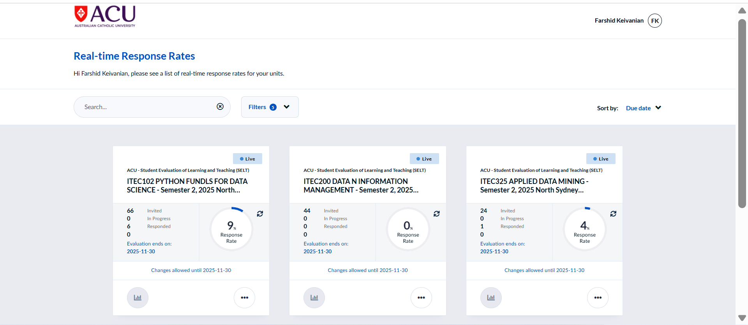
Have You Completed the Survey
It is currently showing 0 submission

Slide 79

Thank You
Happy Learning and Bright Futures Ahead! Dr. Farshid Keivanian Stay Connected: linkedin.com/in/farshid-keivanian github.com/FarshidKeivanian
Education is the most powerful weapon you can use to change the world. — Nelson Mandela

